Slide 1
Employee Attrition Factors
Hiya Gaine
Jul 2020

Slide 2
BUSINESS PROBLEM
Poke portland jean shorts cred waistcoat williamsburg. Poke kickstarter kogi messenger bag echo park paleo bushwick tumblr tofu.
Live-edge yuccie poutine artisan blue bottle fixie gentrify.
Migas freegan jianbing raw denim microdosing. Normcore knausgaard roof party, next level enamel pin flannel sriracha hoodie raclette kickstarter.
Chambray tofu microdosing typewriter farm-to-table letterpress copper mug raw denim post-ironic crucifix normcore heirloom gentrify.

Slide 3
DATA SOURCES
IBM created a synthetic dataset that can be use to understand how various factors affect employee attrition and satisfaction.
Some of the variables include education, job involvement, performance rating, and work-life balance.
We will explore this dataset and see if there are any significant variables that indeed affect employee satisfaction and attrition.
Then take it a step further and see if we can rank the variables from most important to the least.

Slide 4
APPROACH
Feature selection to determine biggest contributing factors towards employee attrition
Methods used for feature selection – chi-squared and mutual information. Library used - scikitlearn
Data visualization and analysis to better understand how and to what extent the factors affect employee decision to leave
Data visualization libraries used – seaborn and plotly

Slide 5
CHI-SQUARED FEATURE SELECTION
Chi-square test measures dependence between stochastic variables
This function “weeds out” the features that are the most likely to be independent of class and therefore irrelevant for classification
This test has been used to determine the top 15 most important features (independent variable) in the dataset that affect Attrition (target variable)
The feature_selection.SelectKBest(chi2) function has been used from the sklearn library to compute the chi score
https://scikit-learn.org/stable/modules/classes.html#module-sklearn.feature_selection

Slide 6
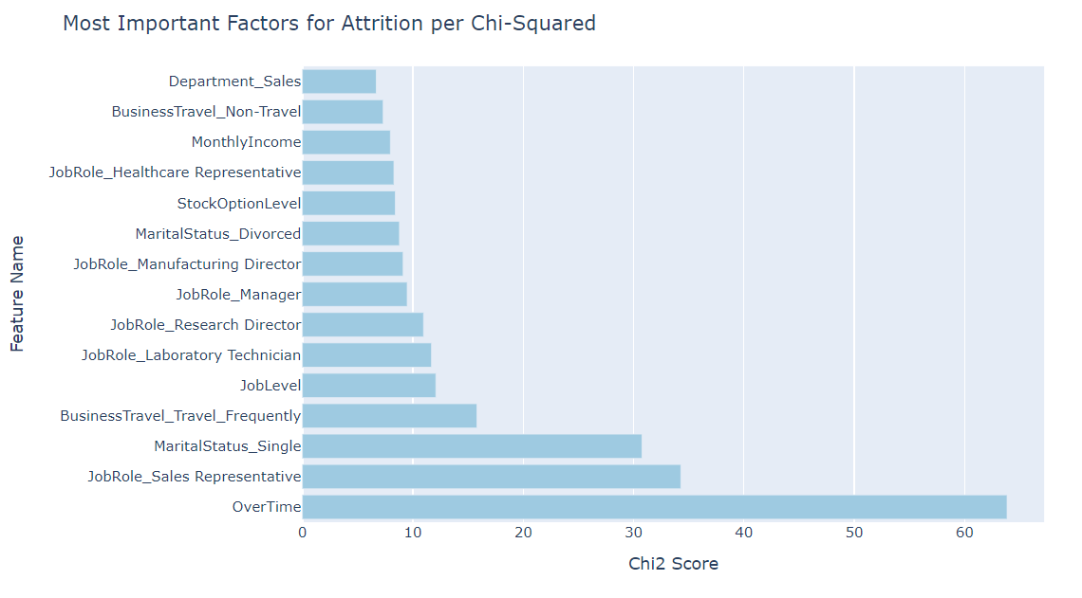
CHI-SQUARED - TOP FACTORS

Slide 7
MUTUAL INFORMATION FEATURE SELECTION
Mutual Information test estimates mutual information for a discrete target variable.
Mutual information (MI) between two random variables is a non-negative value, which measures the dependency between the variables.
This test has been used to determine the top 15 most important features (independent variable) in the dataset that affect Attrition (target variable)
feature_selection.SelectKBest(mutual_info_classif) function has been used from the sklearn library to compute the mutual information score
https://scikit-learn.org/stable/modules/classes.html#module-sklearn.feature_selection

Slide 8
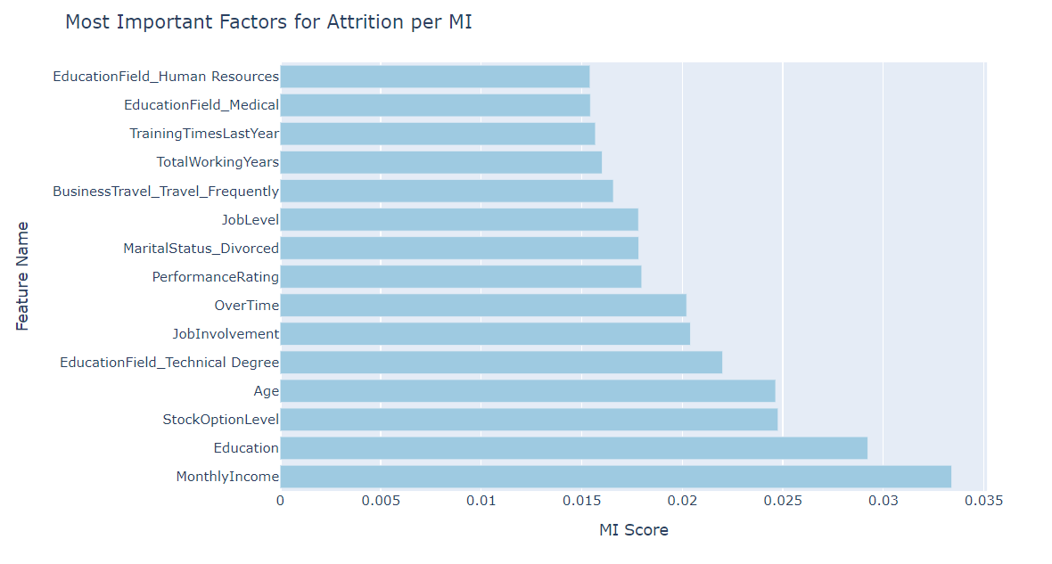
MUTUAL INFORMATION - TOP FACTORS

Slide 9
COMBINED - TOP FACTORS
mi_score | chi2_score | Total | feature_name
1.0000 | 0.8130 | 1.8130 | OverTime
0.4820 | 0.7127 | 1.1947 | MaritalStatus_Single
0.1894 | 1.0000 | 1.1894 | JobLevel
0.1023 | 0.9377 | 1.0400 | YearsInCurrentRole
0.1249 | 0.8889 | 1.0138 | MonthlyIncome
0.5371 | 0.3794 | 0.9165 | JobRole_Sales Representative
0.0612 | 0.7425 | 0.8037 | Age
0.0556 | 0.6341 | 0.6897 | YearsAtCompany
0.1049 | 0.5827 | 0.6876 | Department_Sales
0.2477 | 0.4011 | 0.6488 | BusinessTravel_Travel_Frequently
0.1319 | 0.5095 | 0.6414 | StockOptionLevel
0.0079 | 0.6314 | 0.6393 | YearsSinceLastPromotion
0.1377 | 0.4336 | 0.5713 | MaritalStatus_Divorced
0.0903 | 0.4309 | 0.5212 | TotalWorkingYears
0.0089 | 0.4444 | 0.4533 | WorkLifeBalance
Steps to find top features:
The chi2 and mi scores are scaled to the same level
Average score is calculated and 15 features with highest average score are selected
On the right are the top ranked features and their chi2, mi and total scores

Slide 10
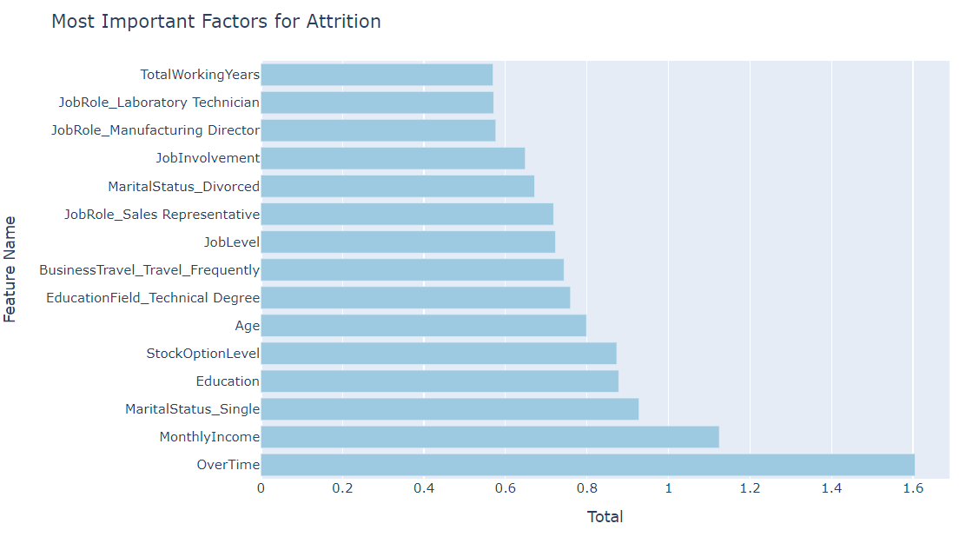
COMBINED - TOP FACTORS CONTD.

Slide 11
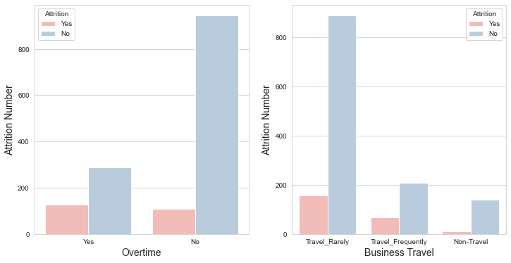
Overtime and Business Travel
Overtime and Business Travel - two most important factors affecting attrition
There is a 33% chance of employee churn among employees doing overtime
Employees who travel frequently are 1.6X and 3X times more likely to leave compared to employees who travel rarely and do not travel

Slide 12
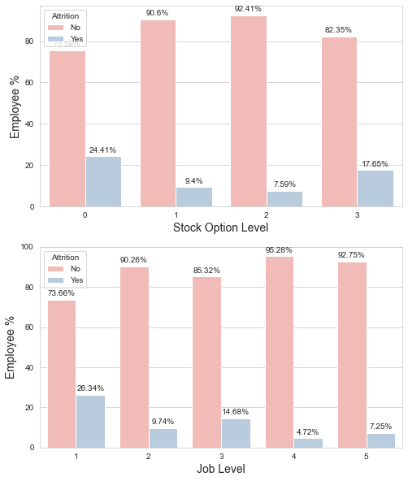
Job Level and Stock Option Level

Slide 13
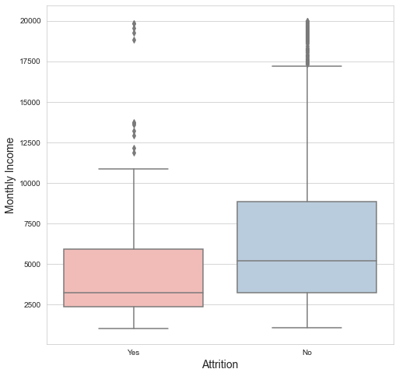
Monthly Income

Slide 14
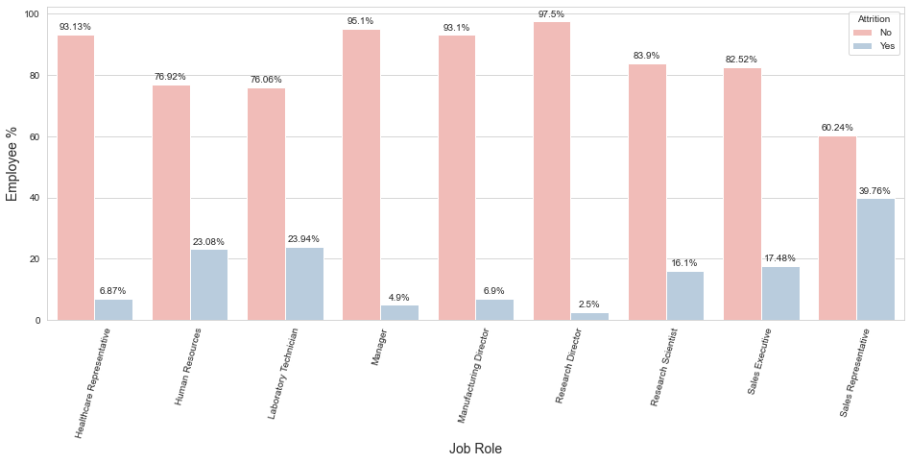
Job Role
Job Roles with highest attrition rates:
Sales Representative
Laboratory Technician
Human Resources
Sales Executive
Research Scientist

Slide 15
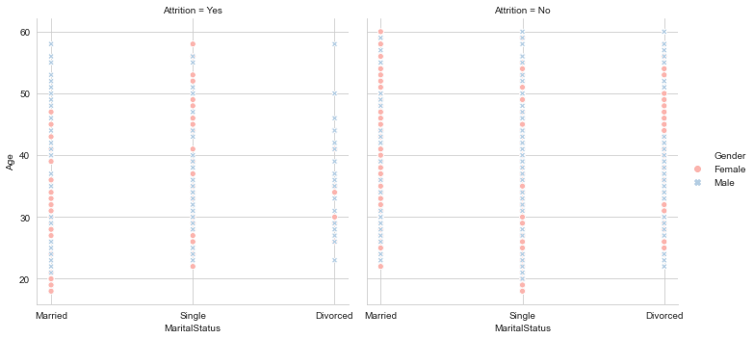
Age, Gender and Marital Status

Slide 16
CONCLUSION
THE END

